Slide 1
DIGITAL PORTFOLIO
STUDENT NAME: P Karunya Lakshmi
REGISTER NO AND NMID: 4C85E68818CAA25A6004C868B3BB206A
DEPARTMENT: B. Sc- Computer Science
COLLEGE: COLLEGE/ UNIVERSITY: O. P. R Memorial Arts And Science College For Women

Slide 2
PROJECT TITLE
Title: Self Portfolio
Subtitle: Showcasing My Work and Skills
Name: Karunya Lakshmi P

Slide 3

AGENDA
Problem Statement
Project Overview
End Users
Tools and Technologies
Portfolio design and Layout
Features and Functionality
Results and Screenshots
Conclusion
Github Link

Slide 4
PROBLEM STATEMENT
In today’s competitive tech world, showcasing projects and skills is essential.
A structured portfolio makes it easier for recruiters/clients to evaluate my expertise.
Lack of a central platform leads to missed opportunities.

Slide 5

PROJECT OVERVIEW
The portfolio is a personal website to showcase:
Projects
Skills
Achievements
Contact details
Responsive and accessible on all devices.

Slide 6
WHO ARE THE END USERS ?
Recruiters – to evaluate skills & projects.
Clients – to check past work before collaboration.
Peers/Community – to share and inspire.

Slide 7
TOOLS AND TECHNIQUES
Frontend: HTML, CSS, JavaScript
Version Control: Git & GitHub
Deployment: GitHub Pages / Netlify
Development: VS-code ( For code representation )

Slide 8

PORTFOLIO DESIGN AND LAYOUT
Clean & minimal layout
Sections:
Home / About Me
Skills
Projects
Contact

Slide 9
FEATURES AND FUNCTIONALITY
Responsive design (works on desktop & mobile).
Navigation menu with smooth scrolling.
Project showcase with screenshots.
Contact form with email integration.

Slide 10
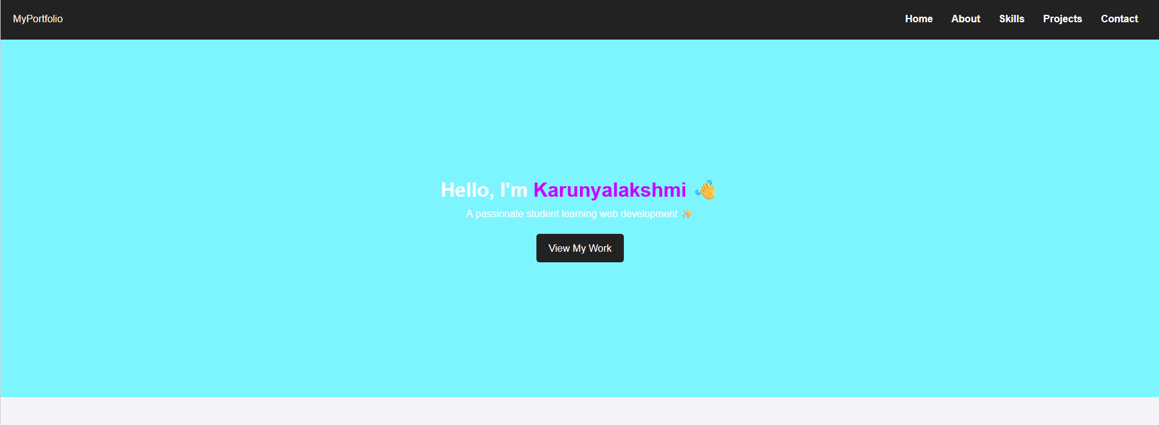
RESULTS AND SCREENSHOTS

Slide 11
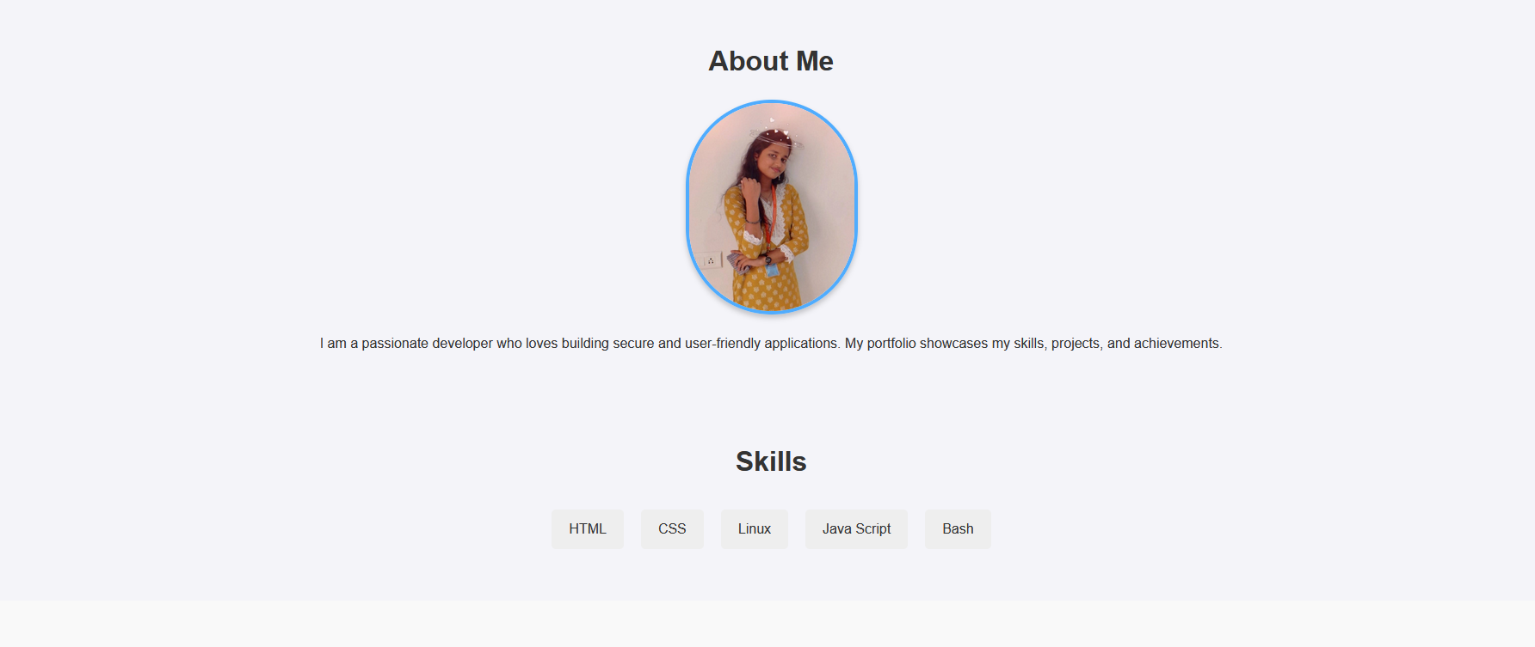

Slide 12
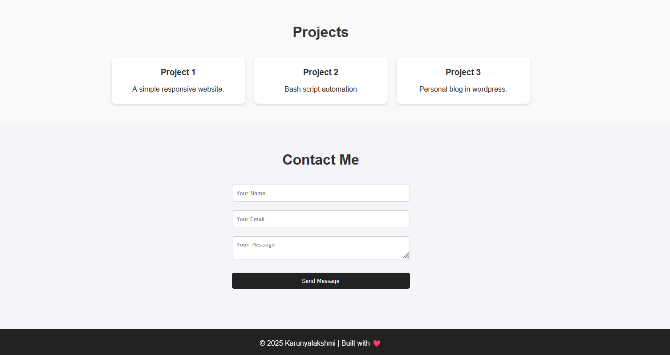

Slide 13
CONCLUSION
A professional portfolio highlights skills and achievements.
Helps in career growth and networking.
Continuous updates keep it relevant.

Slide 14
Github Link
https://github.com/karunyaprabhakar06/Karunya-DIGITAL-PORTFOLIO

